Slide 1


Dairy Express
Presented By-
Mahendra Kolhe(229042)
Sujay Mathane (229099)

Slide 2
Points to be discussed
Screenshots
Specification
Conclusion
Introduction
Motivation
Disadvantages
Future Enhancement
References
Advantages
S/W and H/W
Requirement
Objectives
UML Diagrams

Slide 3
Introduction
This Dairy Express App project will basically be an easy-to-use web application that will allow customers to easily purchase and order products for delivery. It is basically for providing a platform for registering users, categories, products, managing stocks and orders and an end-to-end system from order-to – delivery-to – payment services.

Slide 4
Technology Used:
This project discussed the tool and technology used in developing the proposed system (the system has a front end by REACT to display the content structure and a back end of database using MySQL and Spring Boot i.e. J2EE).
A number of development methodologies were discussed and why one of the methodologies was chosen for this project. Methods used to gather the requirement specification was also discussed and how the researcher will use this as a guideline in developing the proposed system.

Slide 5
UML Diagrams

Slide 6
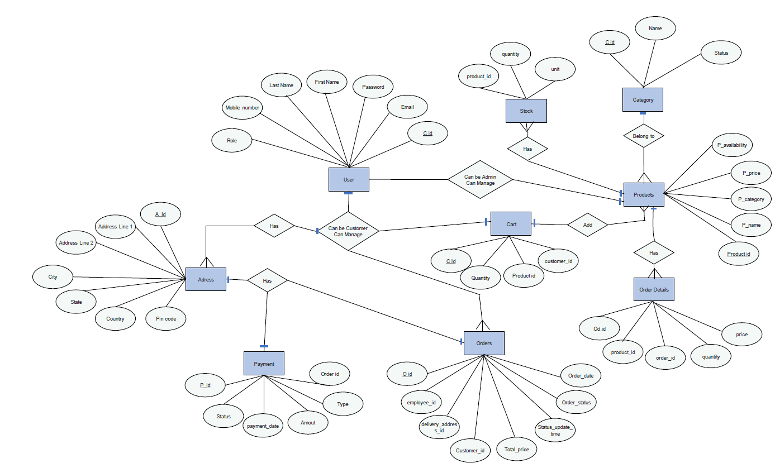
E-R Diagram

Slide 7
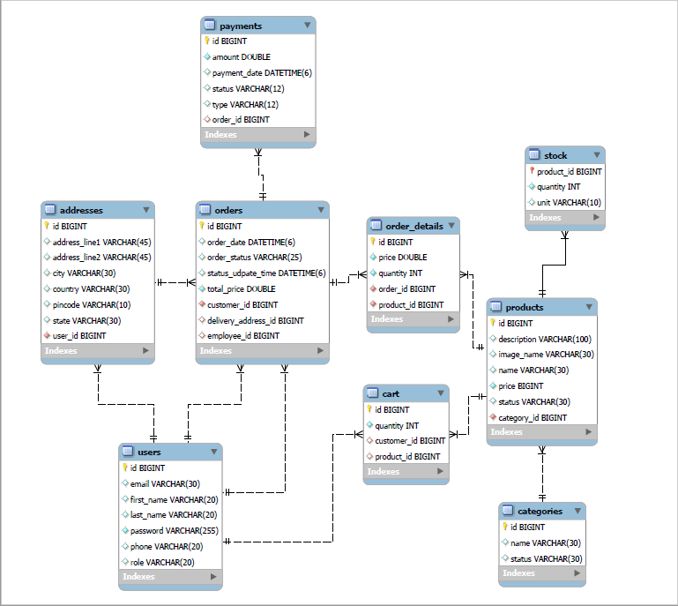
E-R Diagram(MySQL Auto generate)

Slide 8
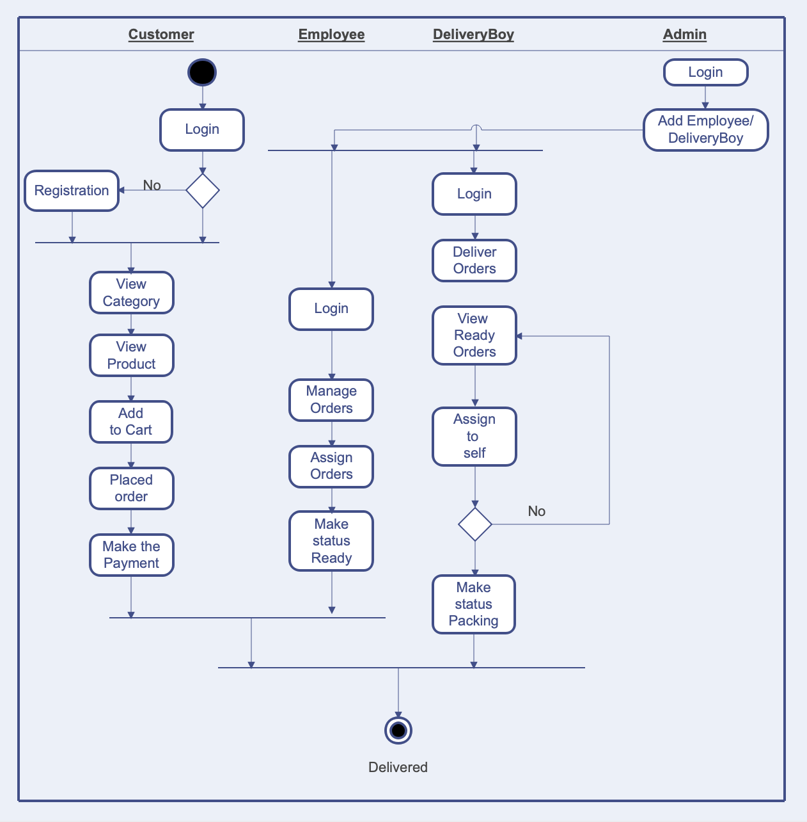
Activity Diagram

Slide 9
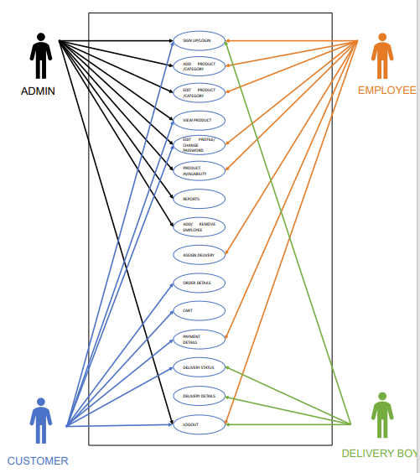
Use Case Diagram

Slide 10
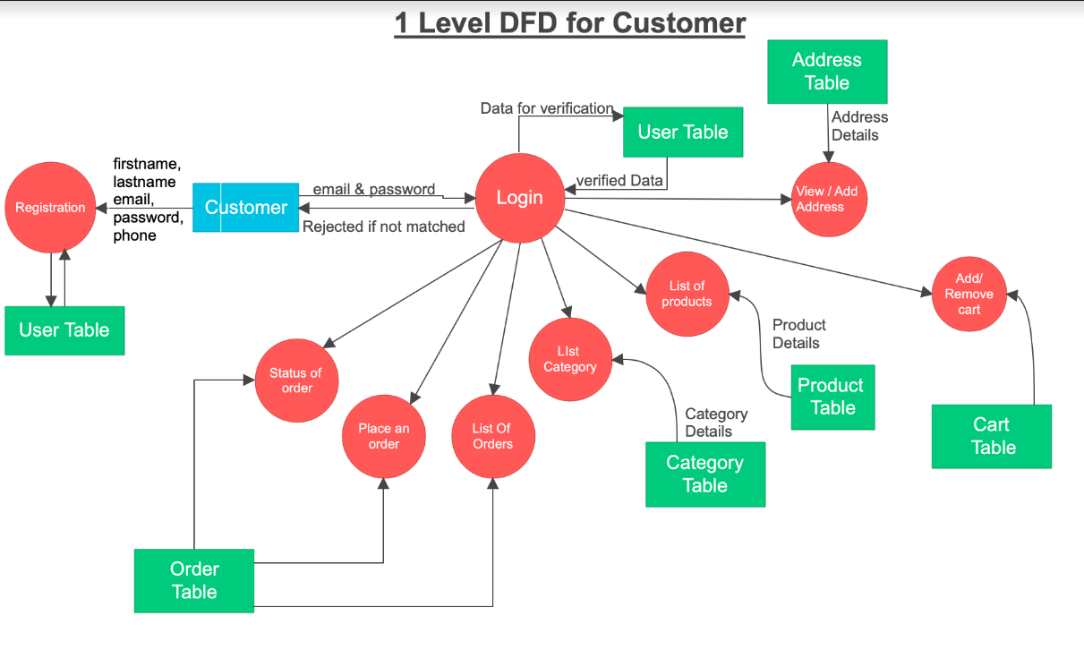
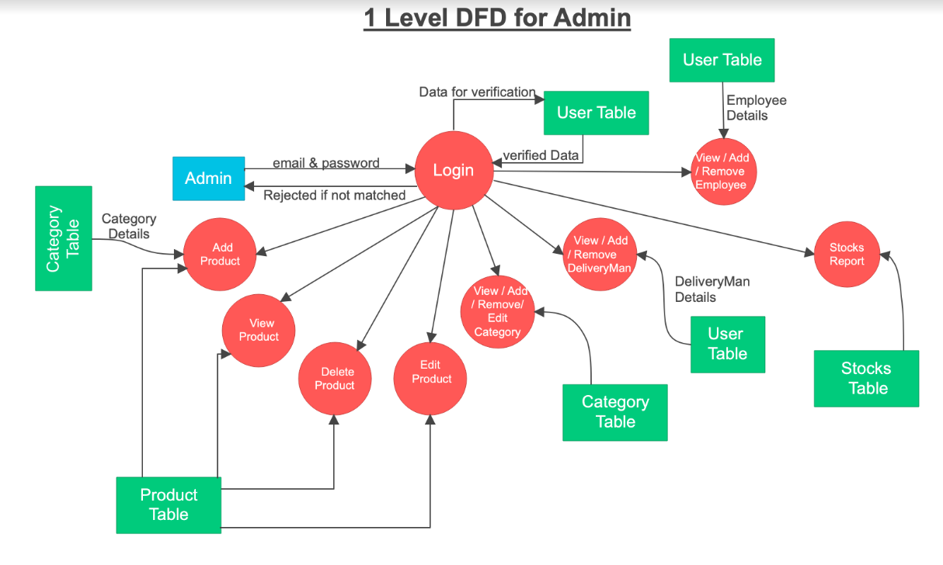
DFD Diagram
Level Two
Level Zero
Level One

Slide 11
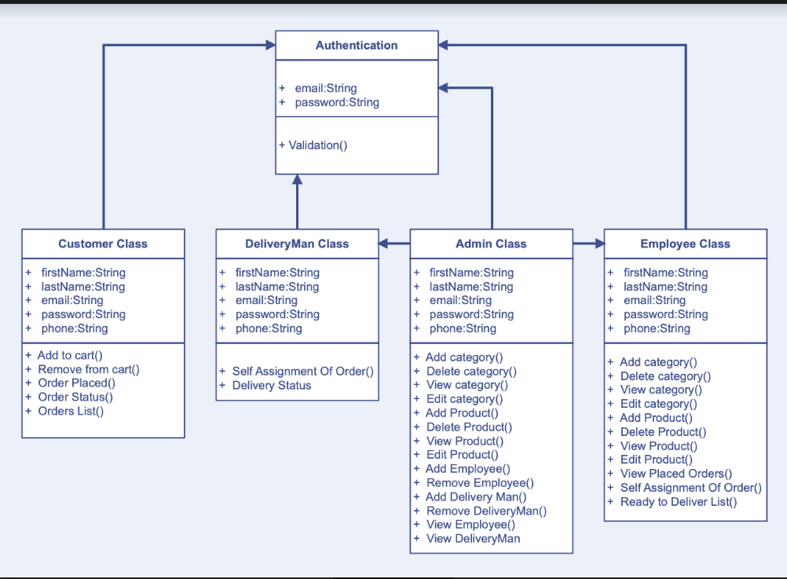
Class Diagram

Slide 12
Screen Shots

Slide 13
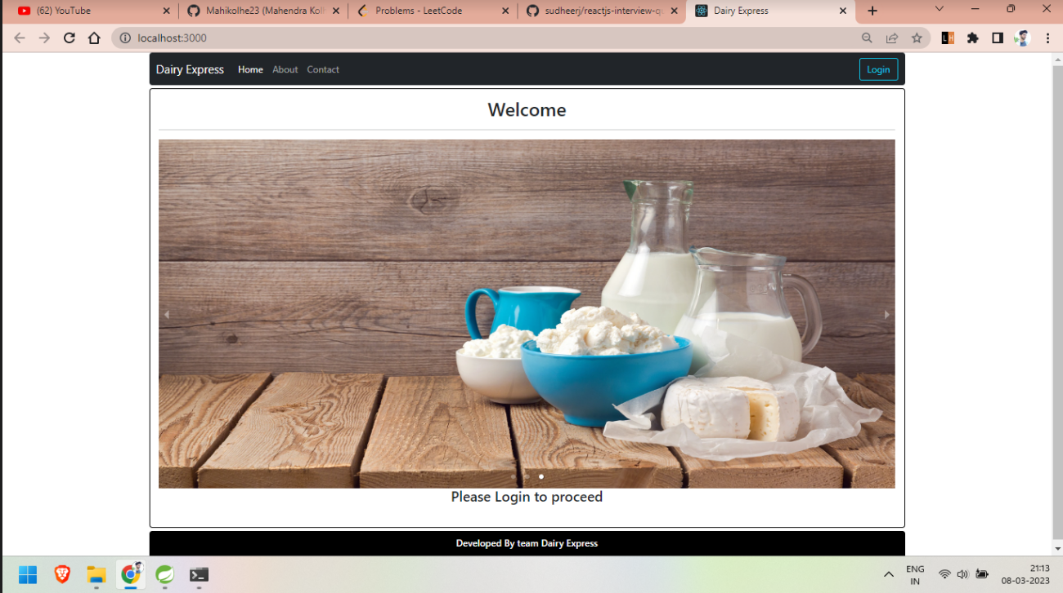

Slide 14
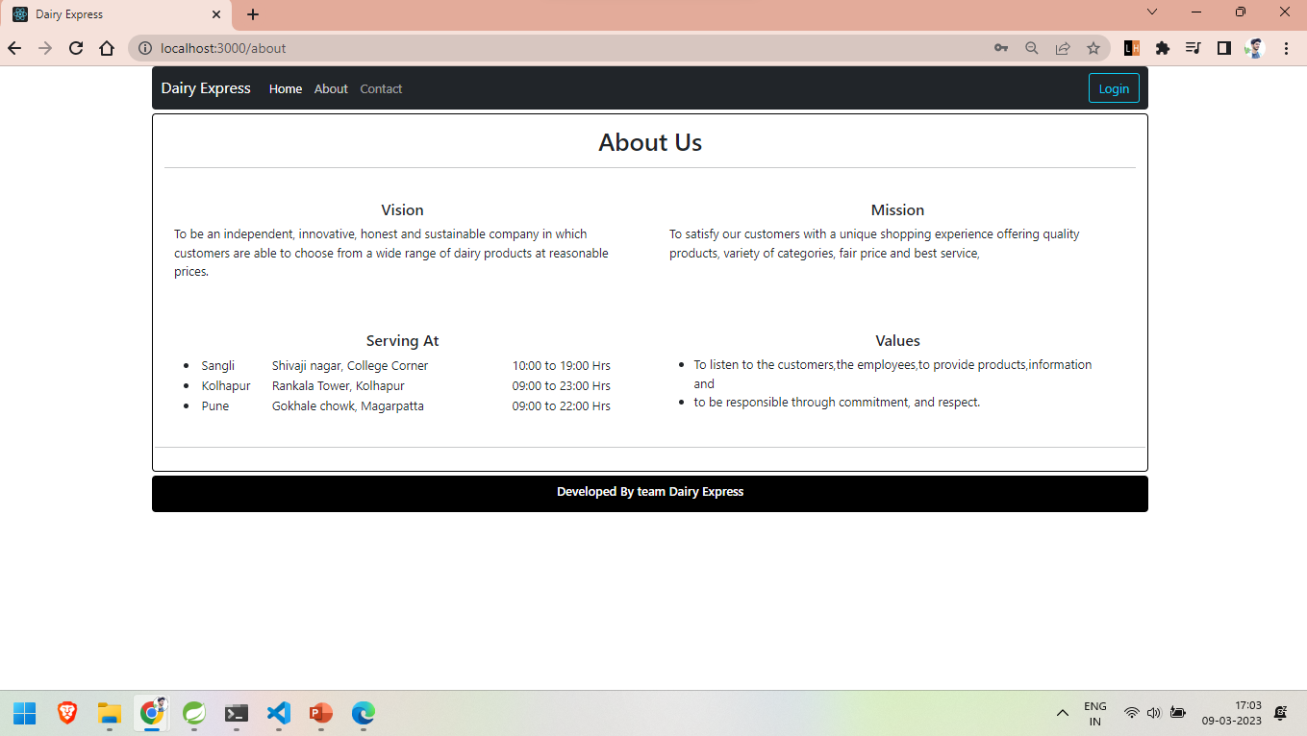

Slide 15
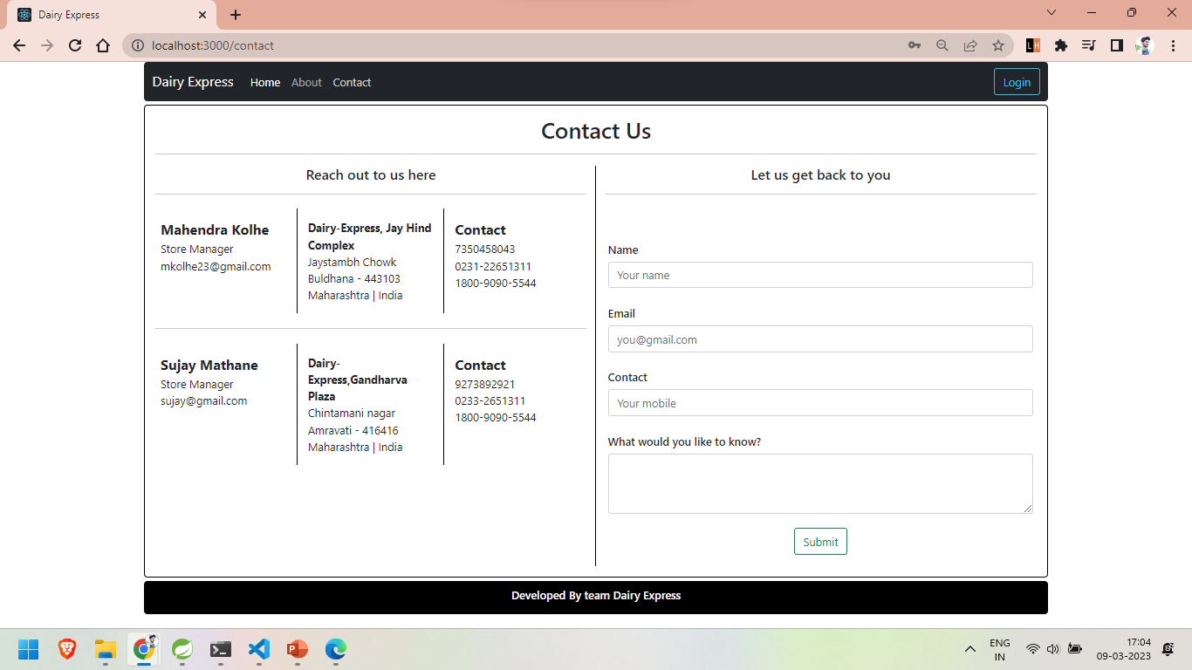

Slide 16
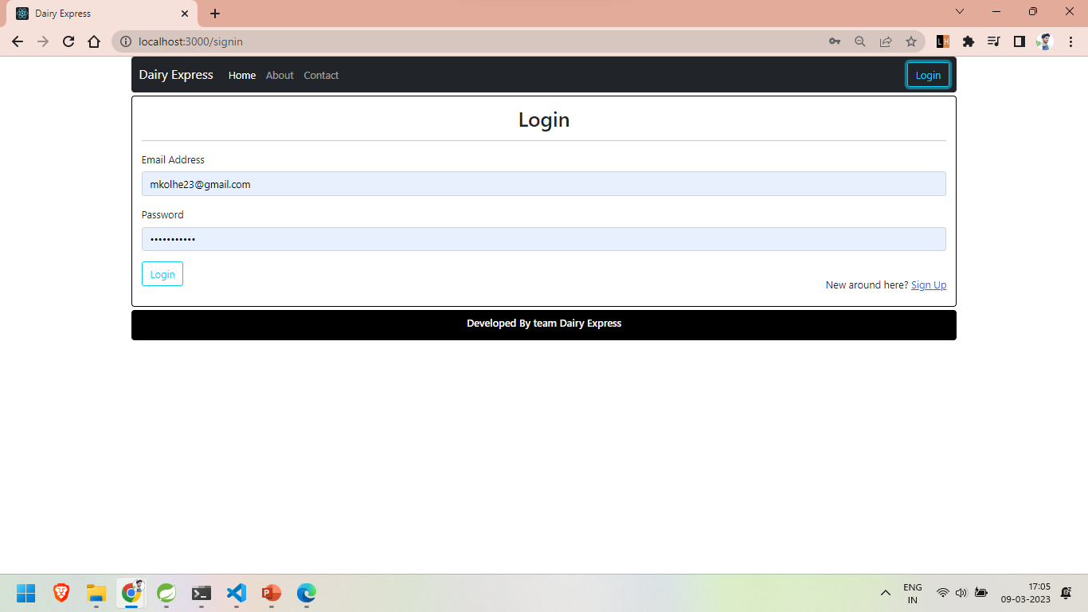
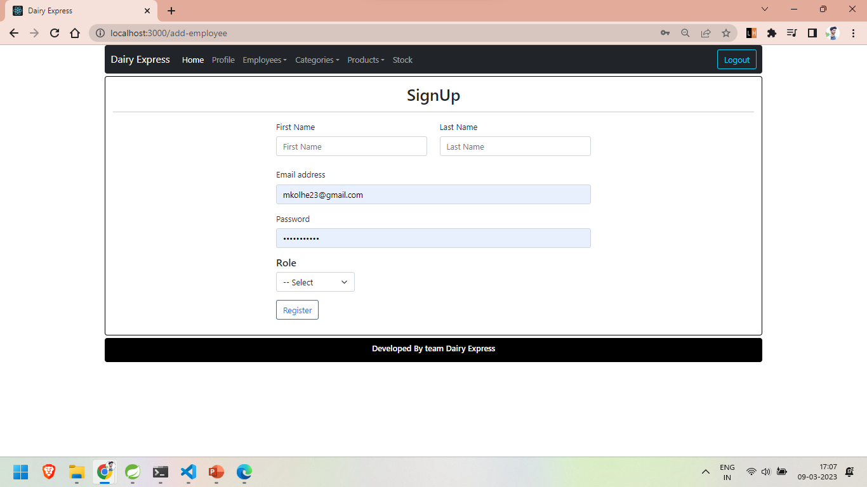

Slide 17
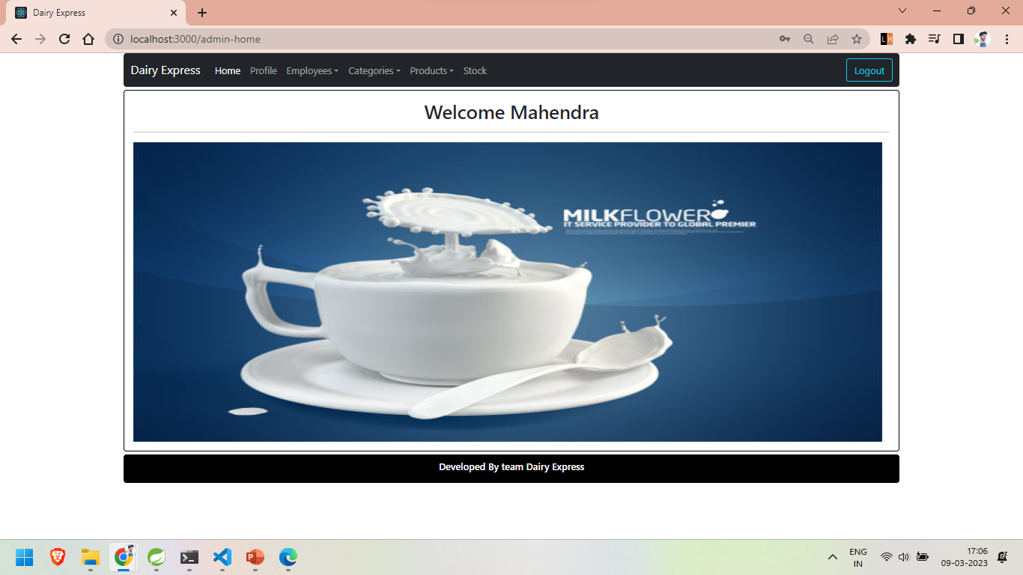

Slide 18
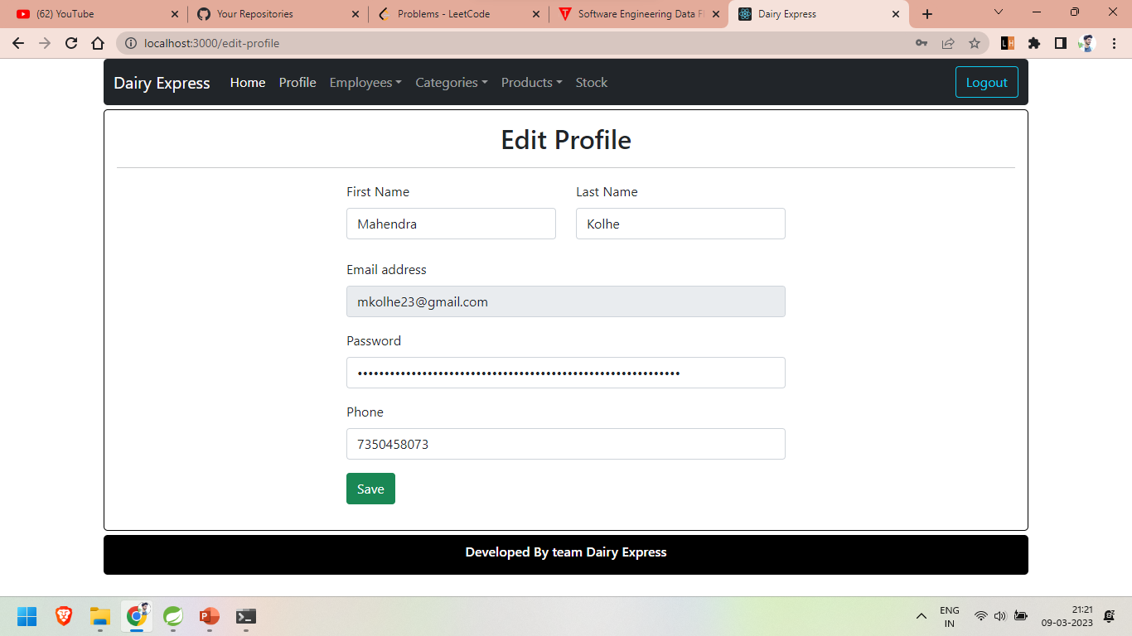
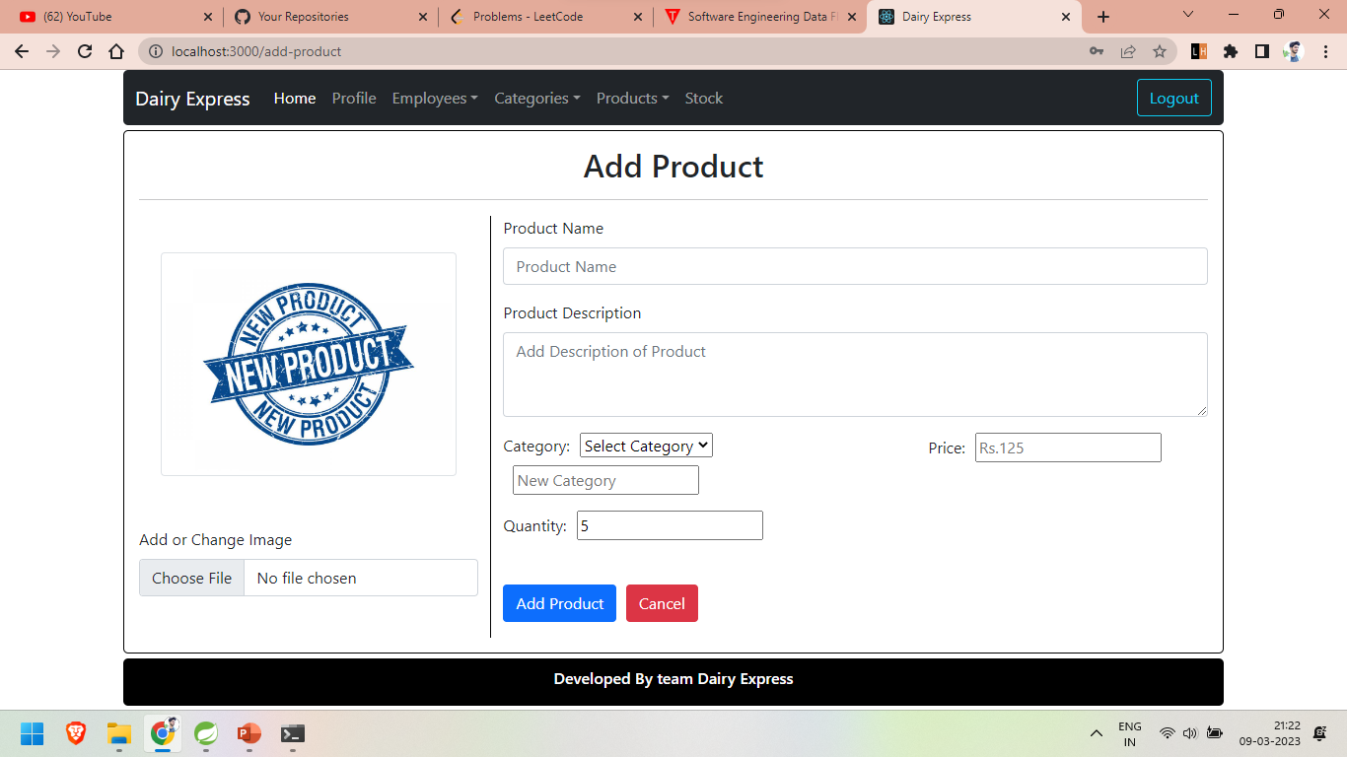
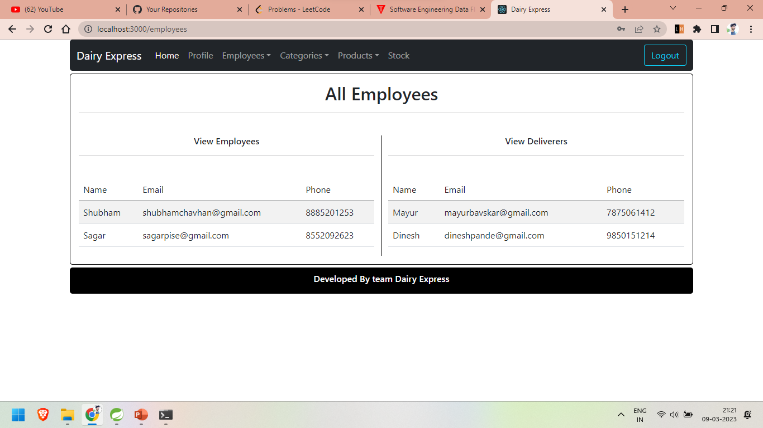
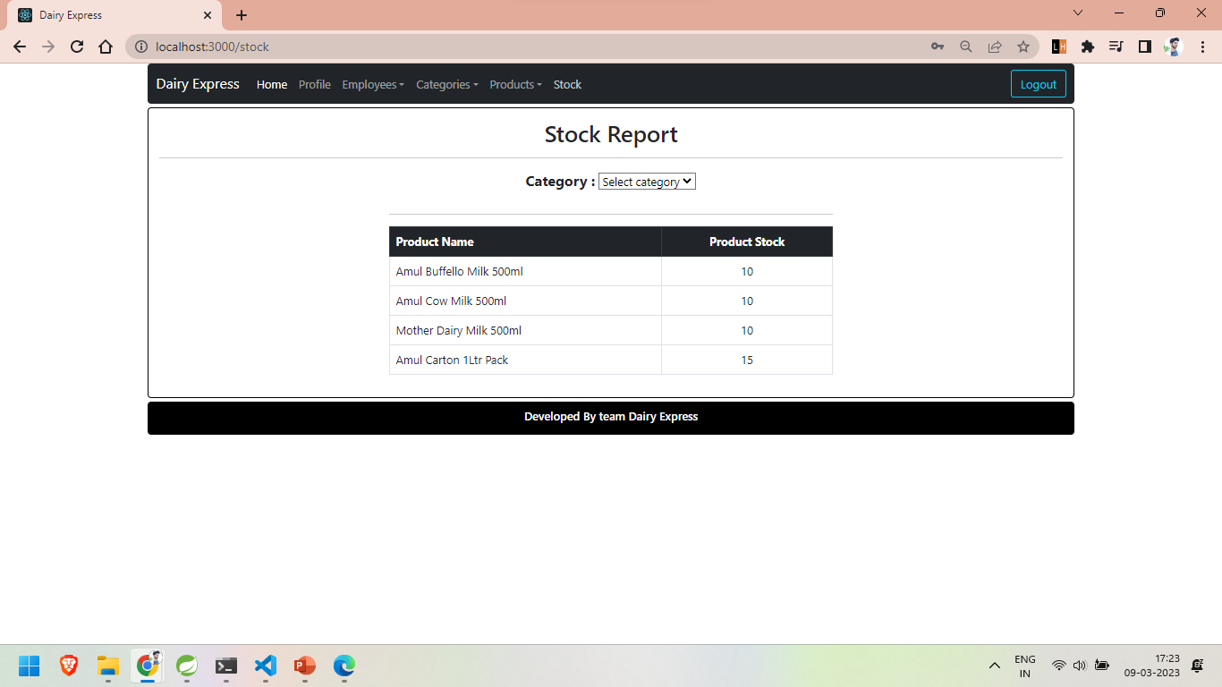

Slide 19
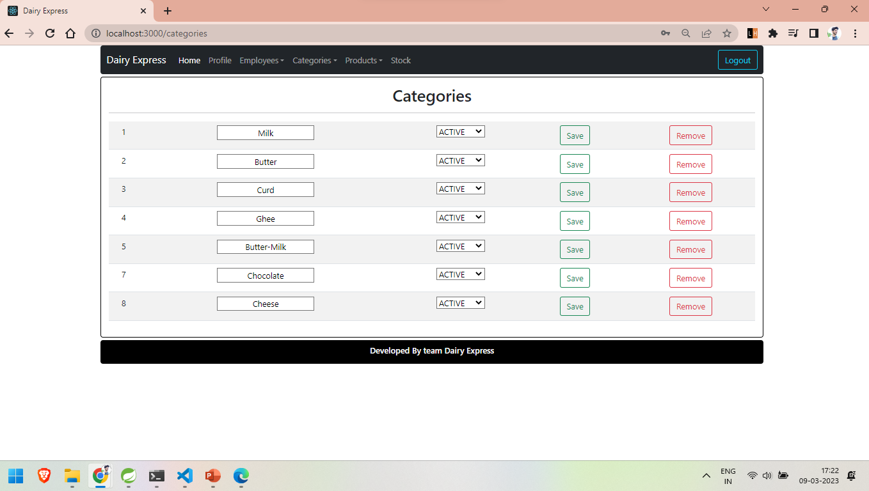

Slide 20
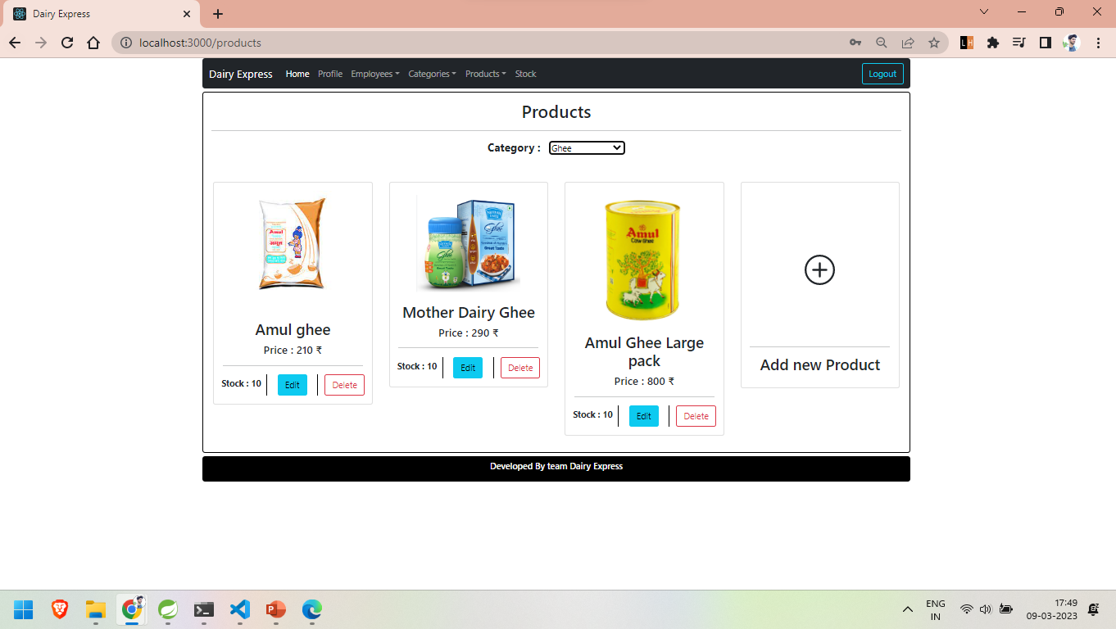
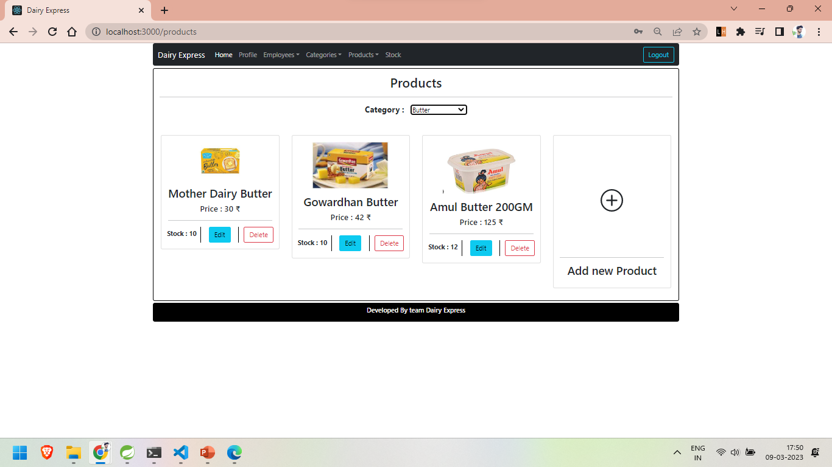
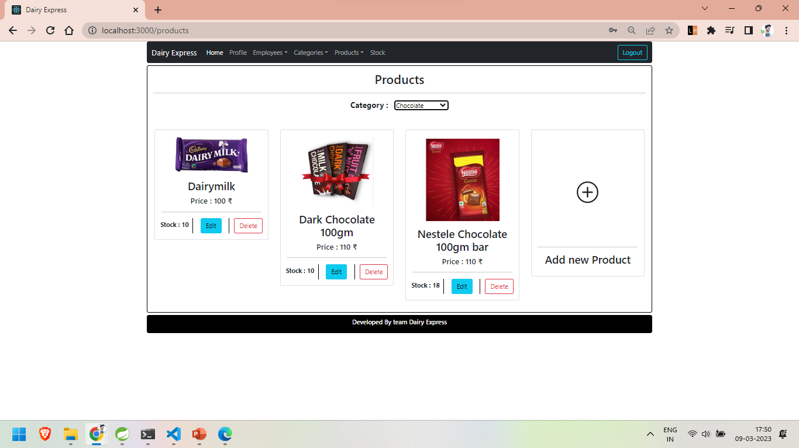
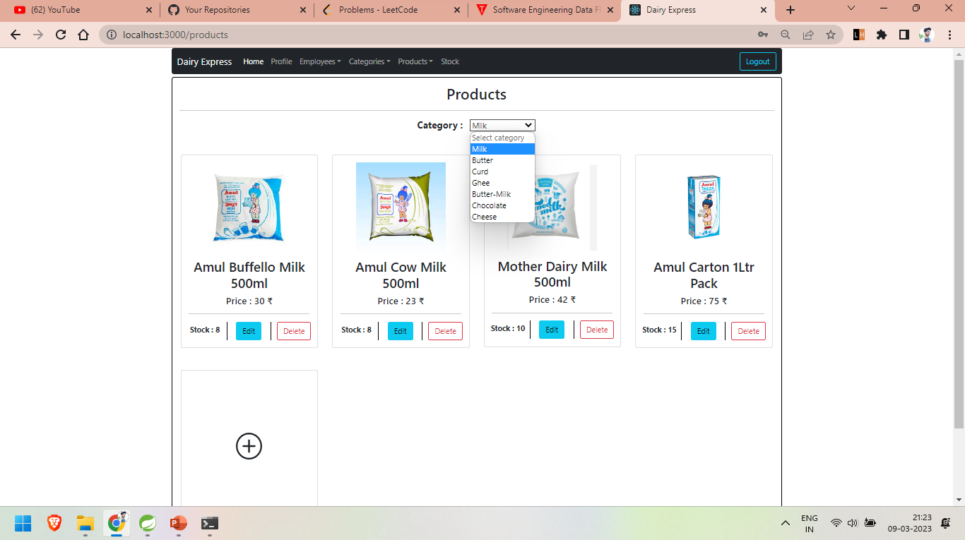

Slide 21
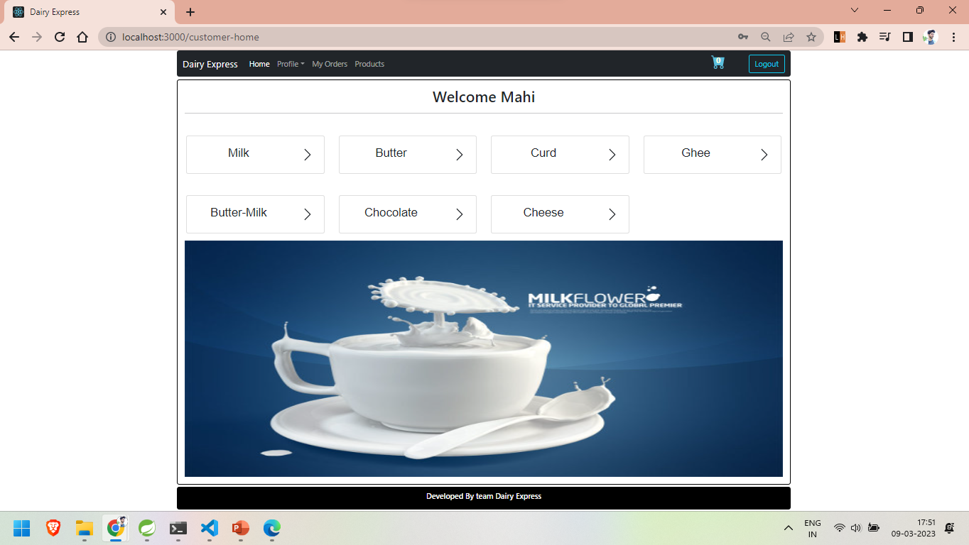

Slide 22
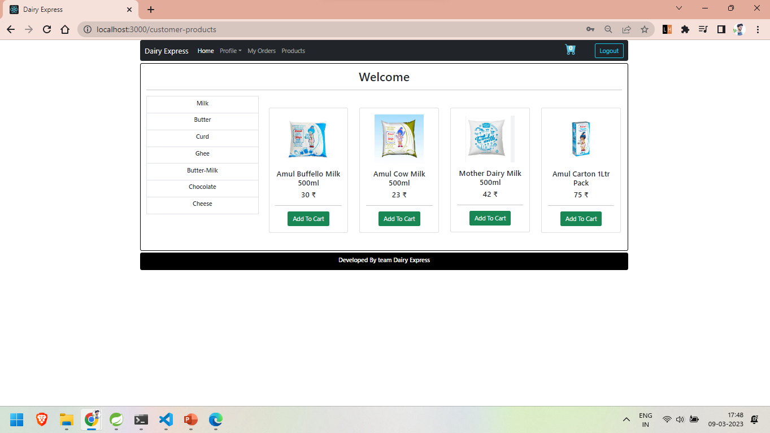
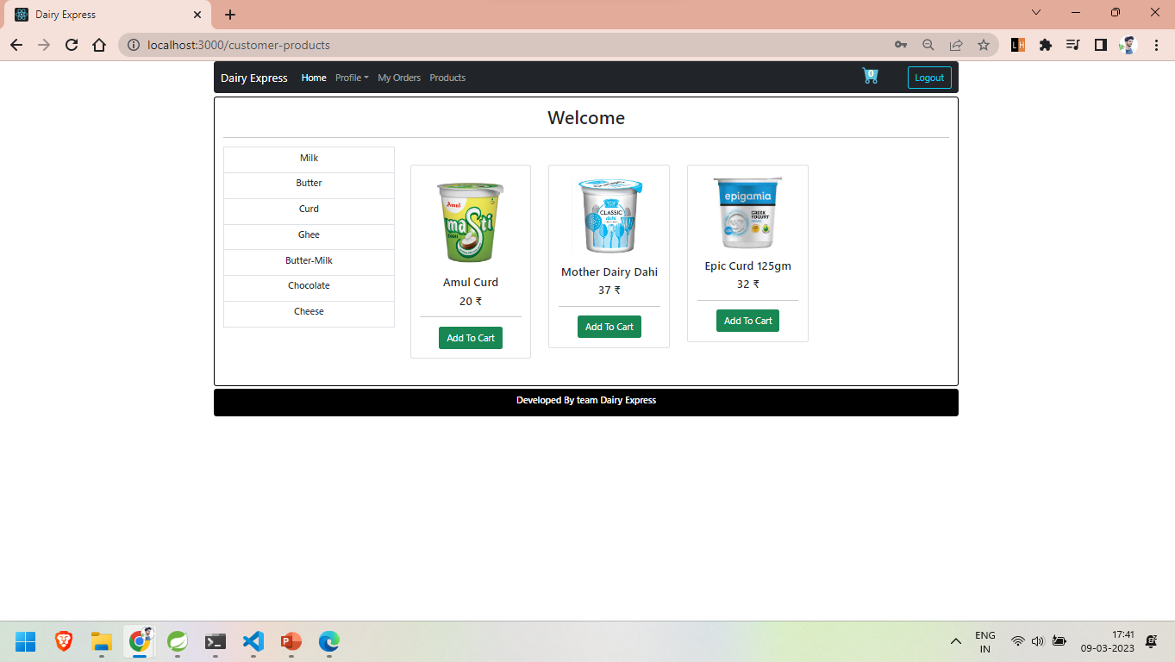
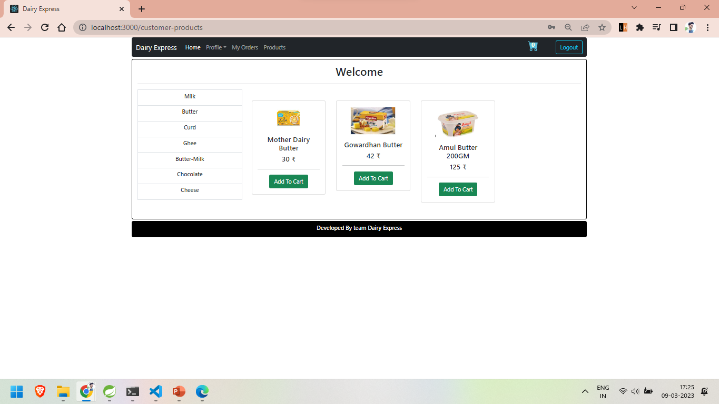
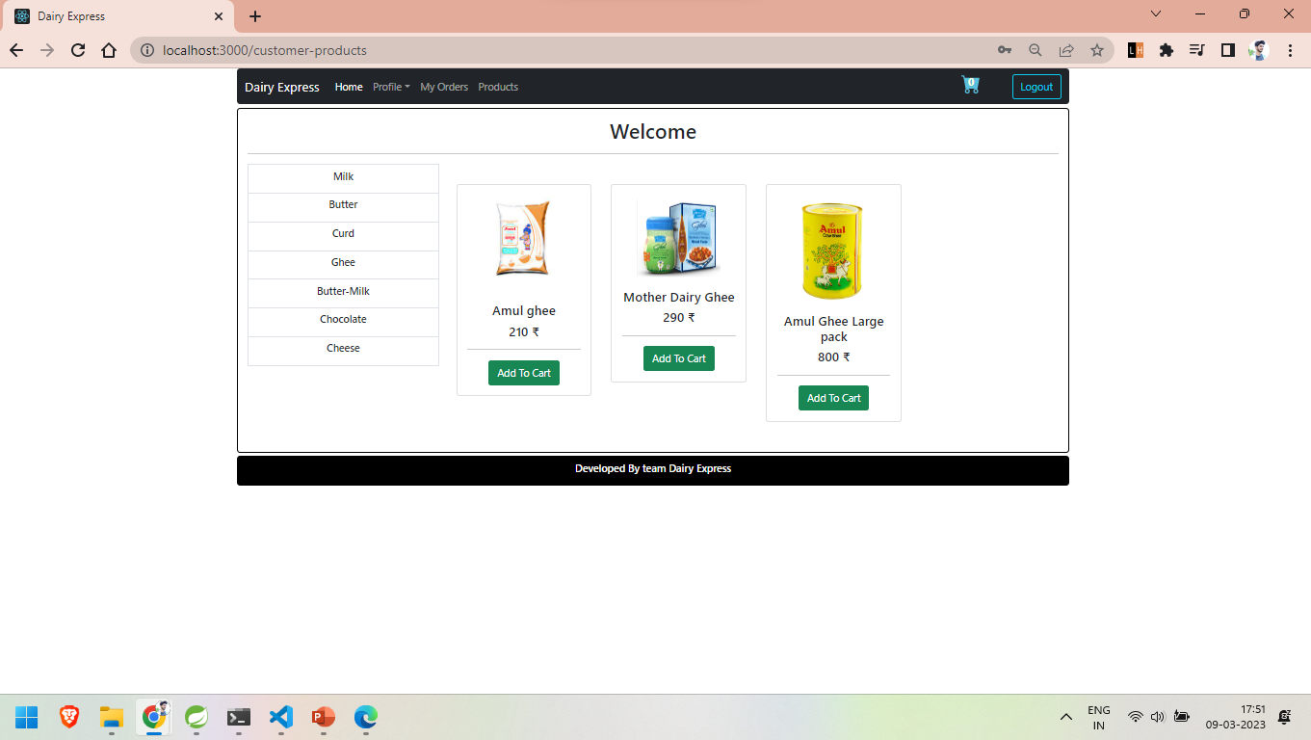

Slide 23
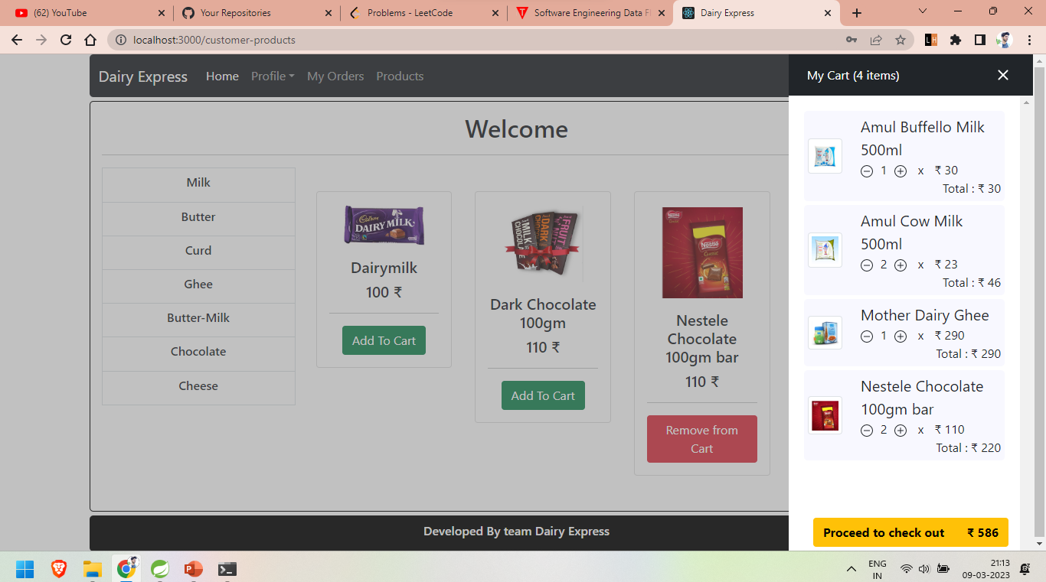
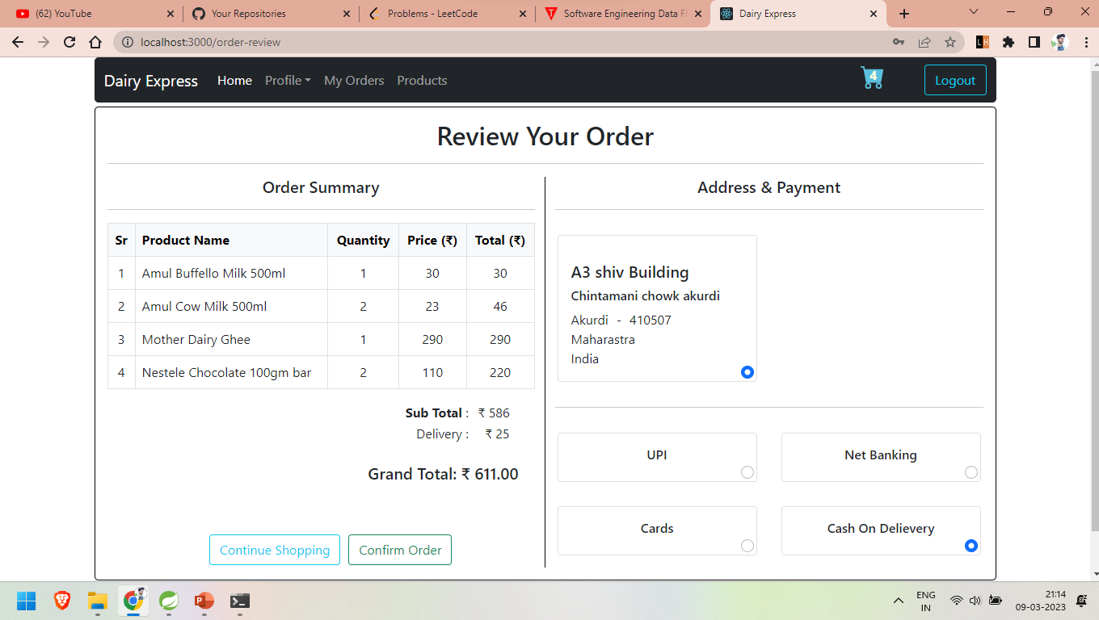
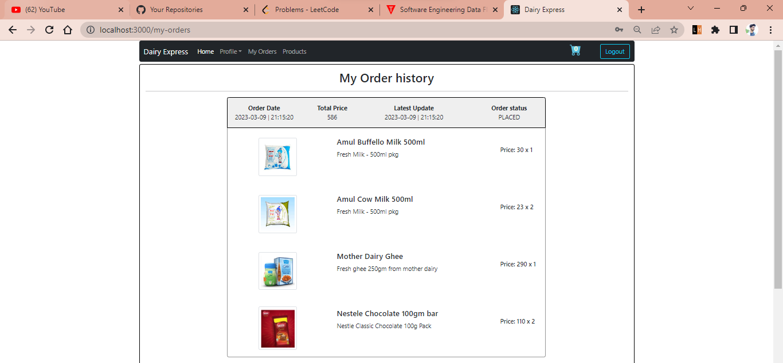
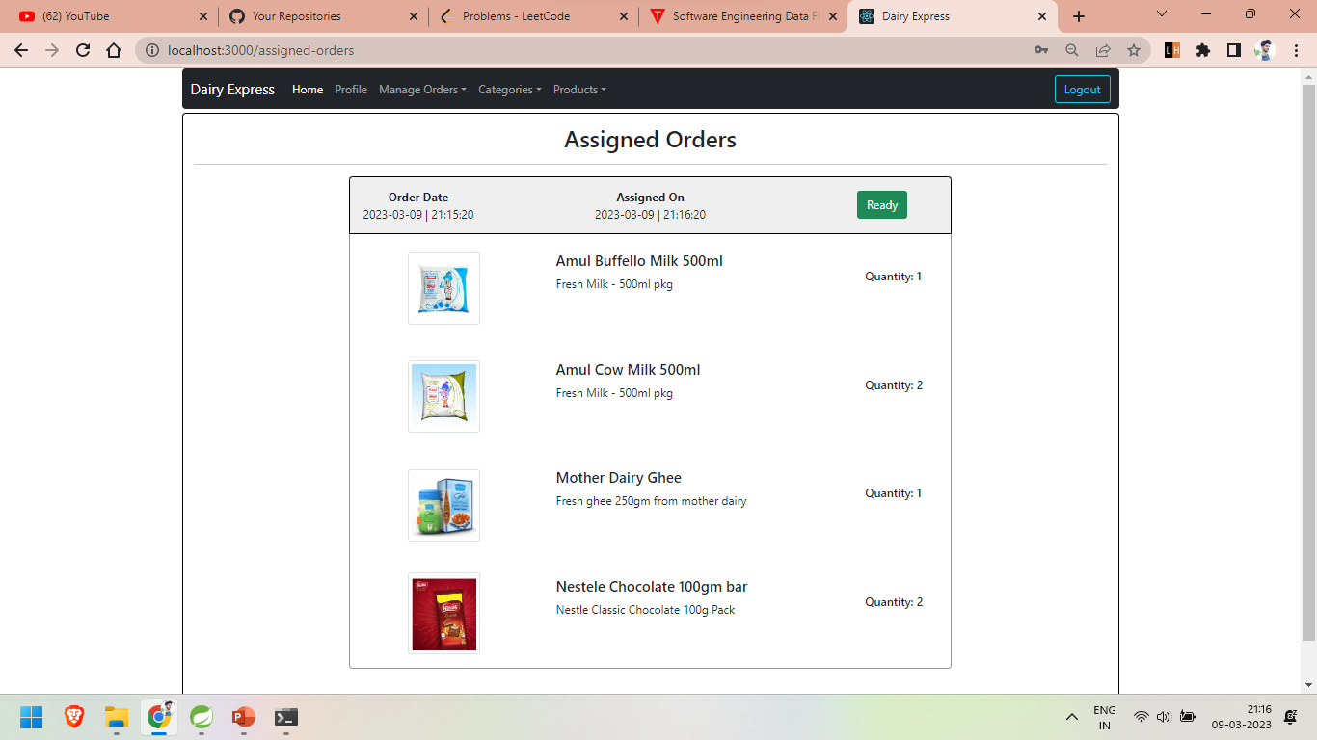

Slide 24
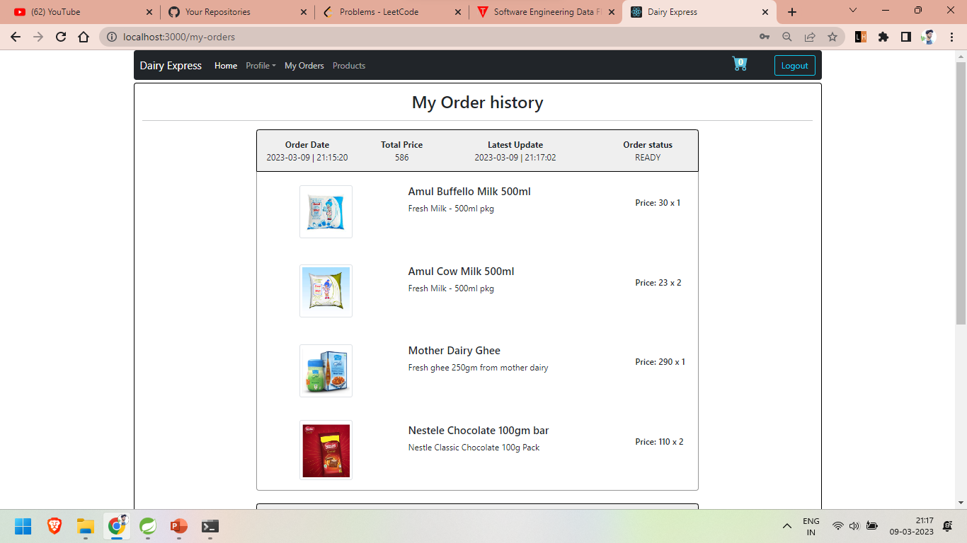
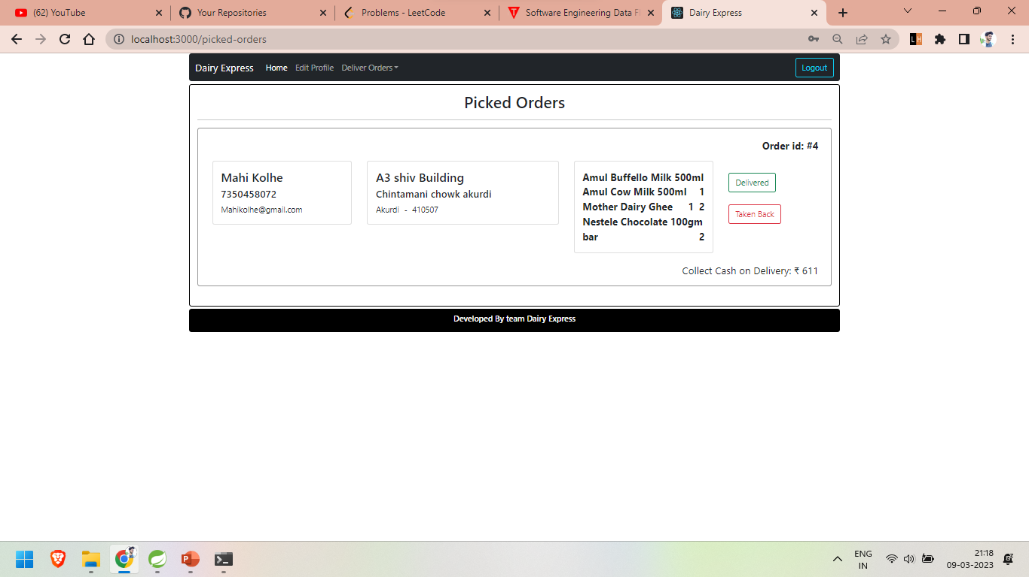
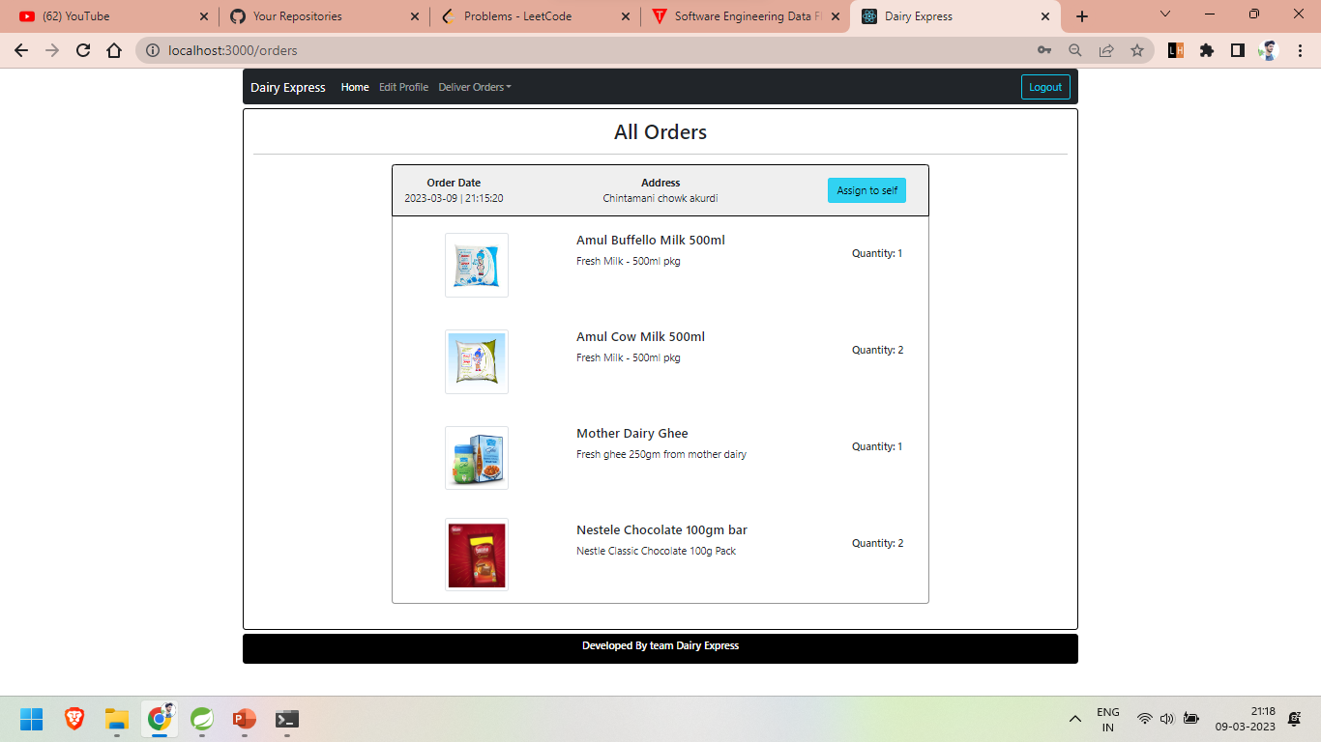


Slide 25
Specification
This project discussed the tool and technology used in developing the proposed system (the system has a front end by REACT to display the content structure and a back end of database using MySQL and Spring Boot i.e. J2EE).
A number of development methodologies were discussed and why one of the methodologies was chosen for this project. Methods used to gather the requirement specification was also discussed and how the researcher will use this as a guideline in developing the proposed system. .

Slide 26
S/W and H/W Requirements
Server Side:
Processor: Intel® Xeon® processor 3500 series
HDD: Minimum 500GB Disk Space
RAM: Minimum 4GB
OS: Windows 10, Linux 6
Database: MySQL
Client Side (minimum requirement):
Processor: Intel Dual Core
HDD: Minimum 80GB Disk Space
RAM: Minimum 2GB
OS: Windows 7, Linux

Slide 27
Advantages
Up Sell your entire dairy products.
Dairy Express Store: 24X7/365 days open.
Dairy Express Allows the Consumers to Choose Delivery Timings.
Dairy Express Manage the Whole Working Easily.

Slide 28
Disadvantages
No online payment facility given, hence payment must be done manually. But this can be done as future enhancement.

Slide 29
Conclusion
Currently small and medium scale Dairy Express don’t have synchronization between their task and customer.
By making online milk product selling we have solved the problem from Dairy Express and customer end and more convenience is added to the existing system.
In future scope this system will be available with large scale database and can accommodate many customers and stores.
To find the location of new customer for that particular city we can add Google API to find nearest Dairy Express.
This system can also be developed on mobile application so that it can be access remotely.

Slide 30
Future Enhancement
For future enhancement we will provide one interface for a person who wants to sell their milk product on our website, So that they can also sell their products without any Hussle.
The software is flexible enough to be modified and implemented as per future requirements.

Slide 31
References
http://www.ijcstjournal.org/volume-7/issue-1/IJCST-V7I1P4.pdf
https://bootstrapmade.com/mentor-free-education-bootstrap-theme/
https://www.javatpoint.com/java-mail-api-tutorial
https://www.w3schools.com/
https://angular.io/docs
https://javaee.github.io/javaee-spec/javadocs/

Slide 32
THANK YOU

